Slide 1
Literature Review

Slide 2
Meaning
It is the process of reviewing past studies so that their conclusions and deficiencies are known and further research can be conducted.

Slide 3
Concept of literature Review
A careful review of journals, books, dissertations, and theses on concerned problem helps researcher familiarize with the methodologies used by others
to find answers to research questions
to find what theories have been put forward and
what gaps exist in the relevant body of knowledge.
It also helps the researches to understand how the findings of his study fit into the existing body of knowledge.

Slide 4
Lit. Review accomplishes the following
It takes the stock of available literatures (examining of existing stock of knowledge)
It establishes a point of departure for future research.
It avoids needless duplication of costly research effort.
It reveals areas of needed research.

Slide 5
Definition
A literature review is the process of locating, obtaining, reading and evaluating the research literature in the area of your interest. Haywood and Wagg (1996)
“A literature review is a summary and analysis of current knowledge about a particular topic or area of enquiry”- N. Williman (2005)

Slide 6
Need / Purpose of Reviewing the Literature
What research has been done in the subject?
What theories have been advanced?
What are the approaches taken by other researchers?
What are the areas of agreement or disagreement in the result?
Whether there are gaps that can be filled through the proposed research?
What are the theories, models, formulas etc developed by other in the concerned topic?

Slide 7
Need / Purpose of Reviewing the Literature
It enables the researcher to define the limits of his field.
It brings the researcher up to date on the work, which others have done.
The researcher can avoid unfruitful and useless problem areas.
The researcher can avoid unintentional duplication of well-established findings.

Slide 8
Need / Purpose of Reviewing the Literature
It gives the researcher an understanding of the research methodology.
It helps the researcher to know about the tools and instruments, statistical methods used in the previous studies.
It helps the researcher to know about the recommendations of previous researchers for further research.

Slide 9
Benefits of a good literature survey
Important variables likely to influence the problem situation are not left out of the study
A clearer idea emerges as to what variables would be most important to consider.
Testability and replicability of the findings of current research are enhanced.
The problem statement can be made with greater precision and clarity

Slide 10
Benefits of a good literature survey
One does not run the risk of reinventing the wheel, that is wasting efforts on trying to rediscover something that is already known and;
The problem investigated is perceived by the scientific community as relevant and of significance

Slide 11
Steps of Lit. review
Locating
Encyclopedias
Obtaining
Efficient and selective reading
Content analysis
Evaluating
Reading
Libraries, Online sources, CD-ROM sources
Card/computer catalogue, Journal index
International bibliographies
Other sources
Keeping track of references, annotate your references , Developing a structure
Critical review, Meta analysis

Slide 12
Step 1 locating materials and composing bibliography
Make a list of topic relevant to subject (it can be deduced from statement of problem)
Look in encyclopedias under possible headings to obtain background information
Go the card or computer catalogue and check it for available literature
Check journal index for pertinent articles
Search internet for matching materials

Slide 13
Make bibliography card for each sources, (and they are alphabetically arranged in a bibliography at the end of thesis format)

Slide 14
Example of 3” by 5” bibliography card for a book
Lucy, T. (1988). Cost Accounting. New Delhi: Tata McGraw Hill Co.
Note: TUCL Call 250.12F234s
Chapter Three is Useful for review

Slide 15
For a Journal article
Hubbard, R.G.(1998).Capital Market Imperfections and Investment. Journal of Economic literature, (36),193-225.

Slide 16
Some reference sources
Encyclopedias
Encyclopedias Britannica
Encyclopedias of social sciences
International encyclopedia of social science
Encyclopedias of education
Mc Graw Hill Encyclopedias of science and technology
Business Encyclopedias and legal advisor

Slide 17
Annual bibliographies
International bibliography of political science
International bibliography of social and cultural anthropology
International bibliography of economics
International bibliography of sociology

Slide 18
Subject literature guides
Hoselitze, Bert. A readers guide to the social sciences-guides available to literature in sociology, anthropology, psychology, economics and geography
Harvey, J.M. (Ed.) Source of Statistics. Guide to important sources in demography, social education, labor, production, finance, tourism etc.
CEDA documentation center-a number of monographs, reports and documents concerning Nepal’s political, economic, social development.

Slide 19
Business literatures indexes
Business periodical index- a cumulative subject index covering 270 business periodicals
Management information guide- offers bibliographic references in many business areas
Topicator –a classified guide to article in marketing periodicals
Personnel management abstracts- an index of articles that deal with the management of people and organizational behavior.
CD-ROM technology-
Index CD-ROMs-electronic bibliographies of thousands of article titles.
Full-text CD-ROMs- access the researchers to read the original articles

Slide 20
Online databases
Dialog,
Predicasts
SSRN
Disclosure ii
ERIC
ABI/INFORM

Slide 21
Literature search through internet
Google
Yahoo
Lycos
Altavista
Hotbot
Go.com
excite.co
Alltheweb.com

Slide 22
Reading and reviewing the literature
Reading involves
Scanning the materials
Gaining some quick impression of what the material is about
Identifying new ideas, issues, methods,
Note taking the relevant points in Note cards

Slide 23
Types of note taking
Direct quotations- it must be taken with care so that the authors word or punctuation is not changed
Paraphrasing-the author’s basic structure is retained, but the information is condensed
Summarizing-appropriate when one wishes to collect the authors main concept but is not interested in keeping the author’s style
Generalization- when the idea of several authors is combined and presented in review it is generalization

Slide 24
Specimen format for note taking cards
Title of the study
Authors
Publication year
Objectives of the study
Problem statement/ hypothesis
Research methods used
Research findings
conclusions

Slide 25
Evaluating the literature
Accuracy and dependability
Suitable to topic.
Consider the arrangement of materials how it is prepared.
Material should be up-to date.
Authority to use.
Illustrations, table, diagrams must be useful.
Who is Author??
Who is Publisher? etc..

Slide 26
Evaluation of literature
Initial part (Author, date of publication, title of journal report etc.)
Evaluate the introduction part (Background of the study, problem of the study, objectives, hypothesis etc.)
Evaluate the methodology used to prepare report or article.
Evaluate the result selection (Conclusion / finding with analysis)

Slide 27
Organizing library findings
After a large collection of note cards with a topic heading, content analysis is conducted to present the findings in a format.
Content analysis is the process of developing a special format of presenting the literature into different mutually exclusive headings.
Presenting the headings of each note card in a logical order should be the basis of organization of library findings.
A broad outline is prepared for organizing the library findings.

Slide 28
For example;
If your research topic is Tourism in Nepal
The following outline may be developed for review presentation
Conceptual background
Historical perspectives
Current situation of tourism
Governments initiatives
Private sectors in tourism development
Problems and prospects
conclusion

Slide 29
Hence organization and presentation of literature review, has the following main points;
Introduction
Problem statement
Analysis
Synthesis
conclusion

Slide 30
The Thought Process: Reasoning Ways to Communicate
Exposition
descriptive statements that merely state and do not give reason
Argument
allows us to explain, interpret, defend, challenge, and explore meaning
Two types of argument of great importance to research are deduction and induction.

Slide 31
Important Arguments in Research
Deduction is a form of inference that purports to be conclusive – the conclusion must necessarily follow from the reasons given. For example;
Man is mortal (premise)
Harry is a man ( case)
So harry dies ( conclusion)

Slide 32
Important Arguments in Research
Induction draws conclusions from one or more particular facts or pieces of evidence. The conclusion explains the facts, and the facts support the conclusions. For example,
Mr A smokes cigarette -fact
Mr B smokes cigarette- fact
Mr C smokes cigarette- fact
Mr A, B and C have lung disease- evidence
Cigarette smoking may lea to lung disease- conclusion

Slide 33
Important Arguments in Research
Deduction is the process by which we arrive at a reasoned conclusion by logically generalizing from a known fact.
Induction is a process where we observe certain phenomena and on this basis arrive at conclusions. In other words, in induction we logically establish a general proposition based on observed facts.
“The nature of induction, however, is that the conclusion is only a hypothesis.”

Slide 34
Deduction
(P1) All regular employees can be trusted not to steal.
(P2) John is a regular employee.
(C) John can be trusted not to steal.

Slide 35
Induction
To induce is to draw a conclusion from one or more particular facts or pieces of evidence.
The conclusion explains the facts, and the facts support the conclusion.
The nature of induction, however, is that the conclusion is only a hypothesis.
It is one explanation, but there are others that fit the facts just as well.

Slide 36
Induction
Fact: “Sales did not increase during or after the promotional campaign.”
Ask: “Why didn’t sales increase ?”
One likely conclusion : “The promotional campaign was poorly executed.”
Others: “Regional retailers did not have sufficient stock”, “A strike by the employees of our trucking firm”, “Hurricane (or typhoon)”.

Slide 37
Induction
The inductive conclusion is an inferential jump beyond the evidence presented.
One conclusion explains the fact, other conclusions also can explain the fact.
It may even be that none of the conclusions we advanced correctly explain the fact.

Slide 38
Understanding Theory: Components and Connections The Building Blocks of Theory
Concepts & Constructs
Operational Definitions & Variables
Propositions and Hypotheses
Theories
Models

Slide 39
Concepts-??????
A concept is a bundle of meanings or characteristics associated with certain events, objects, behaviors and phenomena.
It is a property of an object.
It is general idea about an object that has been given a name.
Concepts have been developed over time through shared usage
Fir example; leadership, personality, motivation, etc.
Generally concepts have accepted collection of meaning. They are coined depending on knowledge available in a society,

Slide 40
What is a Construct?
Abstract concepts are often called constructs.
A construct is an image or idea specifically invented for a given research and/or theory-building purpose.
A construct can be built by combining similar concepts

Slide 41
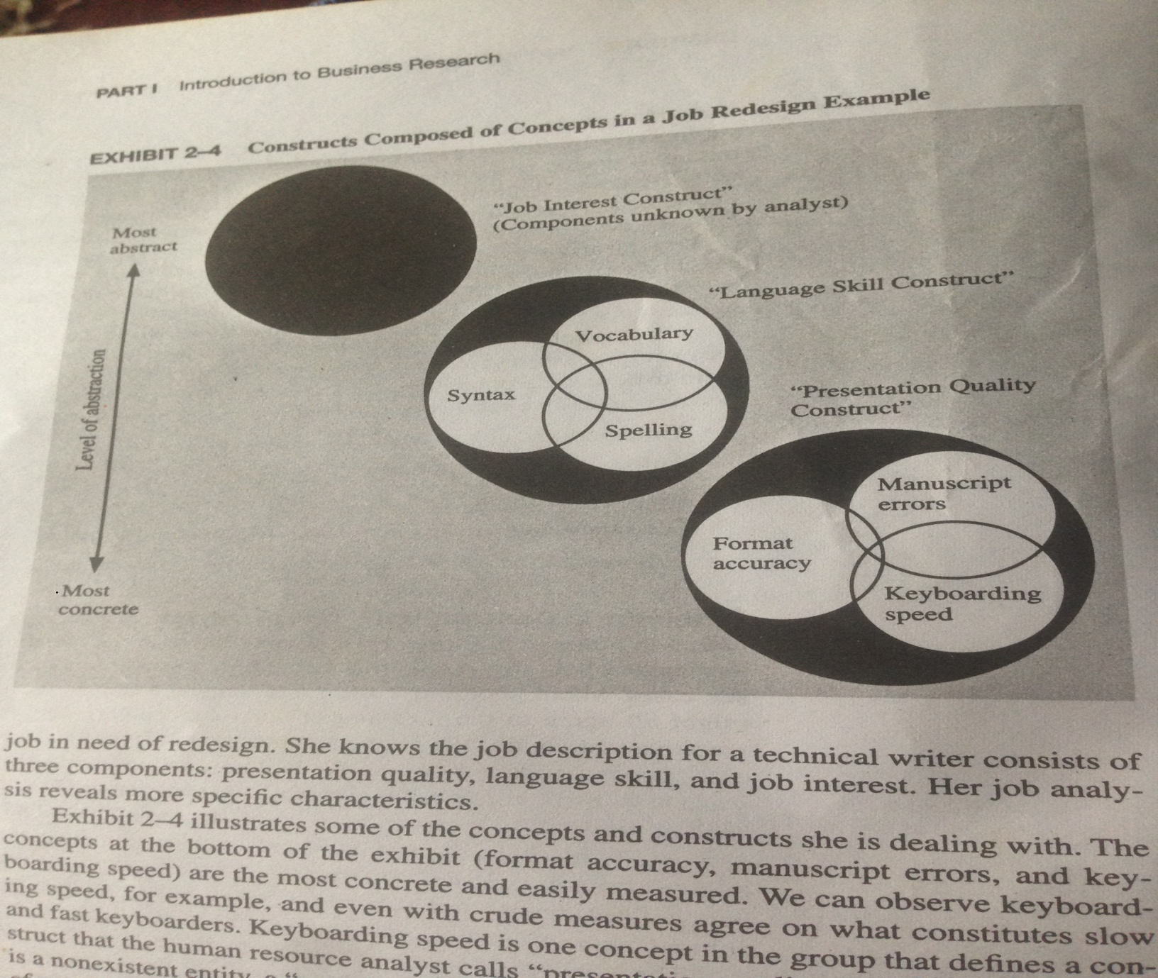

Slide 42
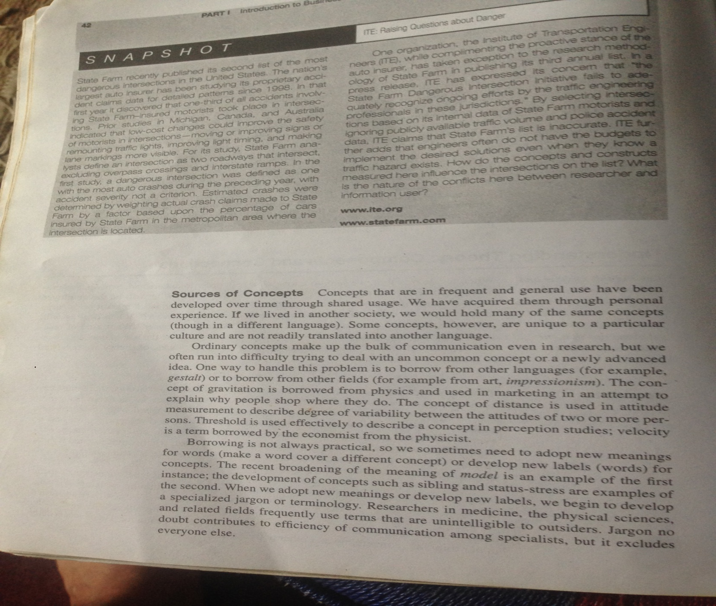

Slide 43
Operational Definition
A definition for a variable stated in terms of specific testing criteria or operations, specifying what must be counted and measured.
Concept | Operational Definition | Variables
Prosperity | Income, wealth, Health | Salary, apartment, real state etc.
Achievement | Educational degree, Job, | Masters, Bachelors, job satisfaction

Slide 44
VARIABLES
Anything that can vary can be considered as a variable. A variable is anything that can take on differing or varying values. For example; Age, Productivity, Absenteeism, Motivation, Income, Height, Weight etc.
The values can differ at various times for the same object or person (or) at the same time for different objects or persons.

Slide 45
Types of Variables
Independent
Dependent
Moderating
Extraneous
Intervening

Slide 46
Dependent Variable
A variable that depends on behavior of other variable is called dependent variable. For example; Effective advertising (IV) leads to higher sales ( DV)
Researchers hypothesize relationships of independence and dependence:
They invent them, and then they try by reality testing to see if the relationships actually work out that way.

Slide 47
Independent variable
The variable whose behavior is independent of changes in other variables is called independent variable.
IVs are also called predictor or cause variable. It is stimulus variable that have impact on dependent variable.
In any explanatory study, independent variable explains the behaviors of dependent variables.
e.g. higher liquidity leads to lower profitability.

Slide 48
Independent and Dependent Variables
Training program
Job performance
Independent Variable
Dependent Variable

Slide 49
Independent and Dependent Variables
Age =Moderating Variable
Employee training
Productivity
Independent variable
Dependent variable

Slide 50
Moderating Variables
A second independent variable, believed to have a significant contributory or contingent effect on the originally stated IV-DV relationship; is called MV.
For example,
The introduction of effective training program (IV) will lead to higher productivity (DV), especially among younger workers (MV).
Visual Ads (IV) increases company sales(DV) specially among the city dwellers (IV).

Slide 51
Moderating Variable
Number of books available
Children’s Reading abilities
Independent variable
Dependent variable
Parents’ literacy
Moderating variable

Slide 52
Extraneous Variables
The variables to assume (because they have little affect, or their impact is randomized) or excluded from a research study.
In routine office work (EV), job training (IV) will lead to higher productivity (DV), especially among younger workers (MV).

Slide 53
Intervening Variables
A variable that affects the observed phenomenon but cannot be seen, measured, or manipulated, thus its effect must be inferred from the effects of the independent and moderating variables on the dependent variable.
For example; The introduction of the four-day workweek (IV) will lead to higher productivity (DV) by increasing job satisfaction (EV).

Slide 54
Intervening Variables
Time:
t1
t2
t3
Workforce
diversity
Creative
synergy
Organizational
effectiveness
Independent variable
Intervening variable
Dependent variable

Slide 55
Intervening Variables
t1
t2
t3
Workforce
diversity
Creative
synergy
Organizational
effectiveness
Independent variable
Intervening variable
Dependent variable
Managerial
expertise
Moderating variable

Slide 56
HYPOTHESIS
Hypothesis is a predictive statement that relates two variables i.e. independent variable & dependant variable.
Hypothesis is an assumption, that can be tested and can be proved to be right or wrong.
A problem is a broad question which cannot be directly tested.
A problem can be scientifically investigated after converting it into a form of hypothesis.

Slide 57
HYPOTHESIS
Hypothesis are tentative, intelligent guesses as to the solution of the problem.
Hypothesis is a specific statement of prediction. It describes in concrete terms what you expect to happen in the study.
Hypothesis is an assumption about the population of the study.
It delimits the area of research and keeps the researcher on the right track.

Slide 58
CHARACTERISTICS OF HYPOTHESIS
Conceptual Clarity - It should be clear and precise.
Specificity - It should be specific and limited in scope.
Consistency - It should be consistent with the objectives of research.
Testability - It should be capable of being tested.
Expectancy - It should state the expected relationships between variables.

Slide 59
CHARACTERISTICS OF HYPOTHESIS
Simplicity - It should be stated as far as possible in simple terms.
Objectivity - It should not include value judgments, relative terms or any moral preaching.
Theoretical Relevance - It should be consistent with a substantial body of established or known facts or existing theory.
Availability of Techniques – Statistical methods should be available for testing the proposed hypothesis.

Slide 60
Propositions Vs Hypotheses
Proposition are statements about concepts that may be judged as true or false if it refers to observable phenomena.
Proposition are expressed as a relationship between concepts, For example;
leadership should be visionary
Higher recognition to job leads employee motivation
When a proposition is formulated for empirical testing, we call it a hypothesis

Slide 61
Descriptive Hypotheses
These are propositions that typically state the existence, size, form, or distribution of some variable.
Examples;
Middle class families are experiencing financial difficulties in Kathmandu.
Q: “Are Middle class families experiencing budget difficulties in Kathmandu ?”
Q: “What is the unemployment rate in Kathmandu ?”

Slide 62
Relational Hypotheses
Describe a relationship between two variable with respect to some cases.
Correlational hypotheses
Male workers have more productivity than female workers in farm houses.
Explanatory (causal) hypotheses
An increase in family income leads to an increase in the recreation and tour activities.
(direction should be considered)

Slide 63
Directional and Nondirectional Hypotheses
Directional hypotheses: the direction of the relationship between the variables (positive/negative) is indicated.
The greater the stress in the job, the lower the job satisfaction of employees.
Or
Women are more motivated in beauty parlor than men are.

Slide 64
Nondirectional hypotheses
Non-directional hypotheses: There are no indication of the direction of the relationships between variables.
There is a relationship between age and Job satisfaction of employee.
Or
There is a differences between the work culture of Madheshi and hilly employees.

Slide 65
Null and Alternate Hypotheses
The null hypotheses is a proposition that states a definitive, exact relationship between two variables.
It states that the population correlation between two variables is equal to zero.
In general, the null statement is expressed as no difference between two groups. For example;
There is no significant difference in productivity of male and female employees. H0: µM = µw
Or
H0: µM - µw = 0
Where H0 represents the null hypotheses,
µM is the mean productivity level of the men,
µw is the mean productivity level of women.

Slide 66
The Alternate Hypotheses
The alternate hypotheses is the opposite of the null hypotheses, is a statement expressing a relationship between two variables or indicating differences between groups. The alternate hypotheses for the above
HA : µM > µw
OR
HA: µAM ≠ µAR
Where HA represents the alternate hypotheses.

Slide 67
The Role of the Hypothesis
Guides the direction of the study
Identifies facts that are relevant
Suggests which form of research design is appropriate
Provides a framework for organizing the conclusions that result

Slide 68
What is a Good Hypothesis?
A good hypothesis should fulfill three conditions:
Must be adequate for its purpose
Must be testable
Must be better than its rivals

Slide 69
Theoretical Framework
A theoretical framework represents your beliefs on how certain phenomena (or variables or concepts) are related to each other (a model) and an explanation on why you believe that these variables are associated to each other (a theory).

Slide 70
Theoretical Framework
Basic steps:
Identify and label the variables correctly
State the relationships among the variables: formulate hypotheses
Explain how or why you expect these relationships

Slide 71
Theoretical Framework
The theoretical framework is the foundation on which the entire research project is based.
It is a logically developed, described, and elaborated network of associations among the variables deemed relevant to the problem situation.

Slide 72
The components of the theoretical framework
The variables considered relevant to the study should be clearly defined.
A conceptual model that describes the relationships between the variables in the model should be given.
A clear explanation of why we expect these relationships to exist.

Slide 73
The Relationship Between the Literature Survey and the Theoretical Framework
The literature survey provides a solid foundation for developing the theoretical framework.
The literature survey identifies the variables that might be important, as determined by previous research findings.

Slide 74
The Relationship Between the Literature Survey and the Theoretical Framework
The theoretical framework elaborates the relationships among the variables, explains the theory underlying these relations, and describes the nature and direction of the relationships.
The theoretical framework provides the logical base for developing testable hypotheses.

Slide 75
Theoretical Framework (1)
Age/ Health
Pay/ Incentives
Employee
Absenteeism
Work environment
Dependent variable
Gender
Independent variable

Slide 76
Theoretical Framework (2)
Communication among cockpit members
Communication between ground control and cockpit
Air-safety
violations
Decentralization
Dependent variable
Nervousness
and
diffidence
Training of cockpit crew
Independent variable
Intervening variable

Slide 77
Theoretical Framework (3)
Communication among cockpit members
Communication between ground control and cockpit
Air-safety
violations
Decentralization
Dependent variable
Training
Independent variable
Moderating variable

Slide 78
Theoretical Framework Among Variables
From Paper Reading Assignment 1
MANAGEMENT STYLE
People-Oriented
H3
H2
USER
PARTICIPATION
H1
SYSTEM
SUCESS
H2
H3
Task-Oriented

Slide 79
Variables
Any concept or construct that varies or changes in value
Main types of variables:
Dependent variable
Independent variable
Moderating variable
Mediating variable (or intervening)

Slide 80
(In)dependent Variables
Dependent variable (DV)
Is of primary interest to the researcher. The goal of the research project is to understand, predict or explain the variability of this variable.
Independent variable (IV)
Influences the DV in either positive or negative way. The variance in the DV is accounted for by the IV.

Slide 81
Examples
List the variables, and label them as dependent or independent, explaining why they are so labeled.
Example 1
An applied researcher wants to increase the performance of organizational members in particular bank.

Slide 82
Answer to Example 1
The dependent variable is organizational performance because it is the primary variable of interest to the applied researcher, who wants to increase the commitment of the members in the bank.

Slide 83
Example 2
A marketing manager wonders why the recent advertisement strategy does not work. What would be the dependent variable here?
Answer: The dependent variable is advertisement strategy because the marketing manager is interested in knowing why the recent strategy does not work.

Slide 84
Example 3
Research studies indicate that successful new product development has an influence on the stock market price of the company. That is, the more successful the new product turns out to be, the higher will be the stock market price of the firm.

Slide 85
Answer to the Example 3
Independent Variable is the success of the new product.
Dependent Variable is the stock market price.

Slide 86
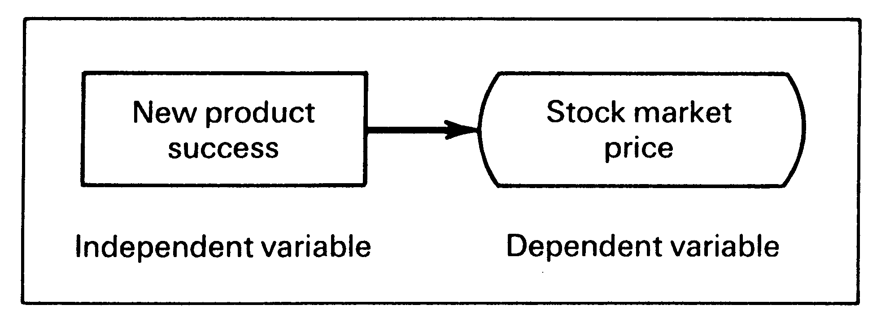

Slide 87
Hypotheses Development
Definition of Hypotheses: Is a logical relationship between two or more variables expressed in the form of a testable statement.

Slide 88
Statement of Hypotheses: Formats
If-Then Statements
Can be used to test whether there are differences between two groups. It takes two forms:
(1) Employees who are more healthy will take sick leave less frequently.
(2) If employees are more healthy, then they will take sick leave less frequently.

Slide 89
Examples for the nondirectional relationship
For the example: The greater the stress experienced in the job, the lower the job satisfaction of employees.
The null hypotheses would be:
Ho: There is no relationship between stress experienced on the job and the job satisfaction of employees.
This would be statistically expressed by:
Ho: P = 0
where P represents the correlation between
stress and job satisfaction, which in this case is equal to 0 ( no correlation).

Slide 90
Example 14
A production manager is concerned about the low output levels of his employees. The articles that he read of job performance mentioned four variables as important to job performance: skill required for the job, rewards, motivation, and satisfaction. In several articles it was also indicated that only if the rewards were (attractive) did motivation, satisfaction, and job performance increase, not otherwise.

Slide 91
Example 14 (cont.)
Given the above situation, do the following:
1. Define the problem.
2. Evolve a theoretical framework.
3. Develop at least six hypotheses.

Slide 92
Example 14 (cont.)
Problem Statement
How can the job performance (output) of the employees be increased through enriched jobs and rewards?

Slide 93
Schematic Diagram for the Theoretical Framework

Slide 94
Hypotheses for Example 14
HA1: If the job is enriched and utilizes all the skills possessed by the employee, then employee satisfaction will be high.
HA2: If the job is enriched and utilizes all the skills possessed by the employee, then employee motivation will be high.
HA3: There will be a positive correlation between satisfaction and motivation.

Slide 95
Hypotheses for Example 14
HA4: Greater rewards will influence motivation and satisfaction only for those employees who find the rewards attractive, not for the others.
HA5: Satisfaction and motivation will positively influence performance.
HA6: The more enriched the job and the greater the skills utilized by the job, the higher the level of employee performance.

Slide 96
Example of Literature Review, Theoretical Framework, and Hypotheses Development
Introduction
Despite the dramatic increase in the number of managerial women during the current decade, the number of women in top management positions continues to be very small, suggesting a glass ceiling effect that women currently face (Morrison, W. & Vura, 1999; Van Velsor,2000).

Slide 97
Introduction (Cont.)
Given the projected demographics of the workplace, which forecasts that for every six or seven women entering the workforce in the future, there will be about only three males joining the labor market, it becomes important to examine the organizational factors that would facilitate the early advancement of women to top executive positions.

Slide 98
Introduction (Cont.)
This study is an effort to identify the factors that currently impede women’s advancement to the top in organizations.

Slide 99
A Brief Literature Survey & Theoretical Framework
Read the paragraphs about the literature survey and theoretical framework for the above example on page 93 from the textbook.

Slide 100
The Hypotheses
1. The greater the extent of gender stereotyping in organizations, the fewer will be the number of women at the top.
2. Male managers have more access to critical information than women managers in the same rank.
3. There will be a significant positive correlation between access to information and chances for promotion to top-level positions.

Slide 101
The Hypotheses
4. The more the gender-role stereotype, the less the access to critical information for women.
5. gender-role stereotyping and access to critical information will both significantly explain the variance in promotional opportunities for women to top-level positions.
(See next Figure)

Slide 102
Figure: schematic diagram of the example

Slide 103
Exercises on Theoretical Framework
Develop a theoretical framework for the following situation and state one testable hypothesis in the null and the alternate.
A school administrator is interested in finding how the threatened teachers’ strike can be averted. He knows that pay demands and the classroom’s physical environment are the two main issues in the situation. He, however, feels that these two are not major concerns for the teachers who are extremely dedicated to teaching.

Slide 104
Exercises on Theoretical Framework (Cont.)
Theoretical Framework
Since the administrator’s main concern is about the strike, teachers’ strike is the dependent variable. Pay and the physical environment of the classroom are the two independent variables, which influence the strike situation.

Slide 105
Exercises on Theoretical Framework (Cont.)
The grater the pay demands made by the teachers, the greater the possibility of a strike, since the school administration refuse the idea of higher wages. The more uncomfortable the classroom physical environment, the more difficult it will be for teachers to do an effective job in the classroom, and hence the greater the possibility of teachers going on strike.

Slide 106
Exercises on Theoretical Framework (Cont.)
However, this relationship between the independent variables and the dependent variable will be true only for those teachers who are not dedicated to teaching. The truly dedicated teachers would be more concerned about doing a good job despite the hardships faced by them, and hence the pay demands and the classroom environment will not be factors influencing their decision to join the strike.
(See Schematic Diagram).

Slide 107
Schematic Diagram

Slide 108
Hypothesis:
H01: Dedication to teaching will not alter the relationship between the independent variables of pay and classroom environment and the dependent variable of teachers’ decision to go on strike.

Slide 109
Hypothesis:
HA1: only for those teachers who are not truly dedicated to teaching, will pay considerations and classroom environment be factors that would influence their decision to go on strike.

Slide 110
Exercise
Here are eight variables:
1) Understanding student needs (by teacher);
2) Developing appropriate teaching strategies (by teacher);
3) In-class examples and exercises;
4) Student entry level skills;
5) Student understanding;
6) Student exam performance;
7) Difficulty of exam;
8) Stress.

Slide 111
Exercise
a. With these eight variables, develop a theoretical framework, treating #4 (Student entry level skills) as a moderator, and variable #5 (Student understanding) as an intervening variable.
b. Develop four hypotheses.

Slide 112
ANSWERS
a. The variance in the performance of students in the exam can be accounted for by the four independent variables – teacher’s understanding of the needs of the students, the different teaching strategies developed by the teacher, the number of in-class examples and exercises that the teacher gives, and how difficult the exam itself happens to be.

Slide 113
ANSWERS (Cont.)
When the teacher understands students’ difficulties and needs, he tries to develop appropriate teaching strategies in order to meet the needs of the students to understand what is being taught, students understanding will increase.

Slide 114
ANSWERS (Cont.)
In addition, if the teacher uses several examples to put across the points and gives exercises in class to test the extent to which students have understood , then, the students’ level of understanding of what is being taught will increase. However, the entry- level skills of the students should be sufficiently adequate to enable them to understand what is being taught. If the student entry level skills and comprehension are very low, then the teachers’ efforts will not work.

Slide 115
ANSWERS (Cont.)
The level of difficulty of the exam is also another factor that would account for the variance in student performance. The more difficult the exam, the more stressed the students will feel while answering the exam, and the lower will be their performance level in the exam. Thus, stress is the intervening variable here.
( see next Figure).

Slide 116
Figure: Schematic Diagram on student performance

Slide 117
Hypotheses
HA1: Only for those who have the requisite entry level skills, will more in-class exercises and examples help increase the students’ level of understanding of the subject taught.
HA2: The more difficult the exams, the greater the stress experienced by the students.

Slide 118
Hypotheses
HA3: The higher the level of stress experienced by the students, the lower their level of performance in the exam.
HA4: When students understand the subject better, they will perform better in the exam.

Slide 119
Developing a theoretical framework

